Slide 1
PPP Protocol
Presenting by:-
Varsha Rani
Assistant Prof. in Deptt. Of CSE
CDLSIET Panniwala mota (Sirsa)

Slide 2
Outline
PPP Protocol
LCP
NCP
PPP Session Establishment Phases
Authentication
PAP
CHAP

Slide 3
PPP Protocol

Slide 4
PPP
Point-to-Point Protocol (PPP) is the name of a single protocol, whereas the “PPP” can be used to refer to the entire suite of protocols that are related to PPP.
The PPP protocol was developed by IETF as a means of transmitting data for more than one network protocol over the same point-to-point serial link in a standard, vendor-independent way.
It can carry IP, Novell IPX, AppleTalk, and DECnet traffic.

Slide 5
PPP
PPP also offers many features that HDLC does not including the following:
Authentication through the Password Authentication Protocol (PAP) and the Challenge-Handshake Authentication Protocol (CHAP)
Compression capabilities with Stacker or Predictor
PPP Multilink, the ability to bundle physical channels into a single logical channel.
Support for Error detection and error recovery features
Encapsulation for multiple routed protocols, including IP, Novell IPX, and AppleTalk

Slide 6
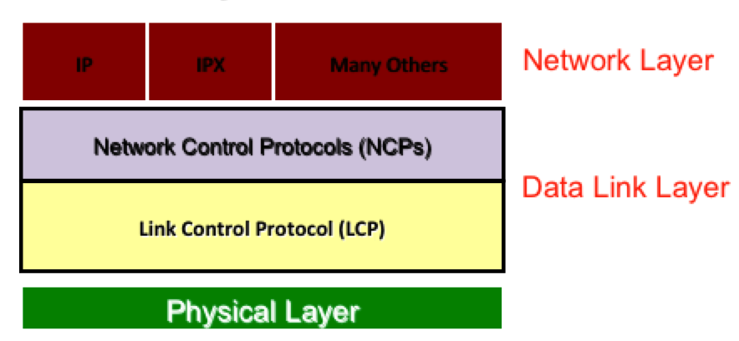
PPP
PPP is a layered protocol, starting with a Link Control Protocol (LCP) for link establishment, configuration and testing. Once the LCP is initialized, one or many of several Network Control Protocols (NCPs) can be used to transport traffic for a particular protocol suite.
Notes:
In terms of the architecture and frame formats, PPP can be seen as three different sub-protocols, for framing and lower level capabilities; it is basically HDLC. If you see the frame formats, it is very similar to HDLC. One sub-layer above is LCP, which provides all of the additional functionality in terms of authentication, multilink, and the general establishment configuration and testing of the data link connection. A third protocol is NCP; it is used for establishing and configuring different network layer protocols. It is basically the interface toward the upper layers.

Slide 7
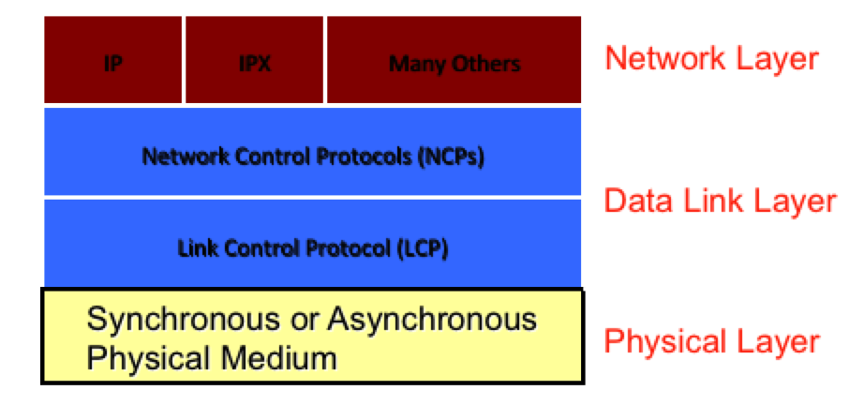
PPP and PHY Layer
PPP operates at the Data Link layer.
At the physical layer, PPP can be used across synchronous (e.g., ISDN, leased lines) and asynchronous (e.g., modem dialup) data links.

Slide 8
HOW PPP Work
The mechanism that PPP uses to carry network traffic is to open a link with a short exchange of packets.
Once the link is open, network traffic is carried with very little overhead. Frames are sent as unnumbered information frames, meaning that no data link acknowledgement is required and no retransmissions are carried out.
So once the link is established, PPP acts as a straight data pipe for protocols.

Slide 9
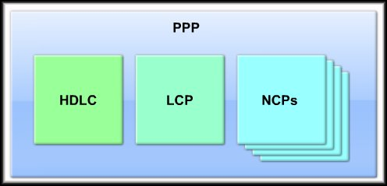
PPP Components

Slide 10
PPP Components
Three main components:
HDLC:
HDLC protocol for encapsulating datagrams over point-to-point links.
LCP:
To establish, configure, maintain and terminate the data link connection.
NCPs:
Family of NCPs for establishing and configuring different network layer protocols.
Allows simultaneous use of multiple Network layer protocols
Notes:
Translation: IP and IPX and others, simultaneously, over a single dialup or higher speed WAN link.

Slide 11
Encapsulation
PPP defines a Protocol Type field.
The protocol type field identifies the type of packet inside the frame,. The following shows a PPP frame.

Slide 12
PPP Data Frame
Flag: delimiter (framing)
Address: does nothing (only one option)
Control: does nothing; in the future possible multiple control fields
Protocol: upper layer protocol to which frame delivered (eg, PPP-LCP, IP, IPCP, etc)
Data: upper layer data being carried
FCS: cyclic redundancy check for error detection

Slide 13
Byte Stuffing
One of PPP design requirements is data transparency.
Transparency means carrying any bit pattern in the data field
data field must be allowed to include flag pattern <01111110>
Q: is received <01111110> data or flag?
Sender: adds (“stuffs”) extra < 01111110> byte after each < 01111110> data byte
Receiver:
two 01111110 bytes in a row: discard first byte, continue data reception
single 01111110: flag byte

Slide 14
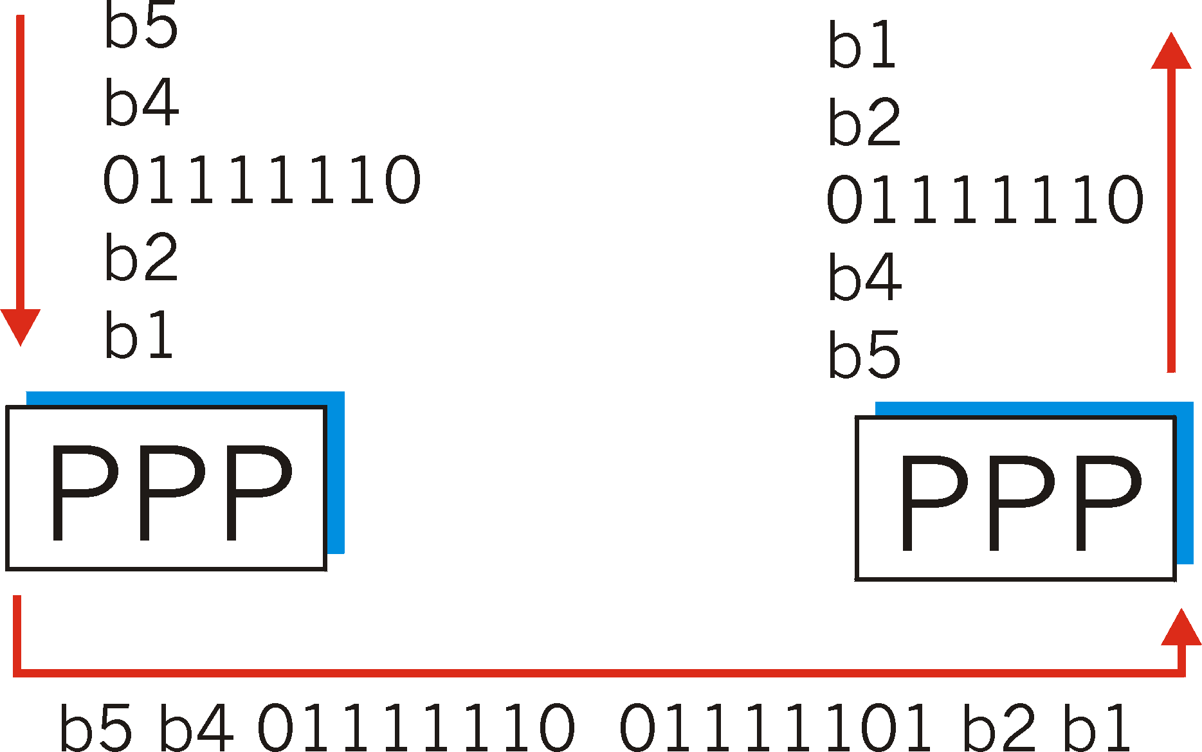
Byte Stuffing
flag byte
pattern
in data
to send
flag byte pattern plus
stuffed byte in transmitted data

Slide 15
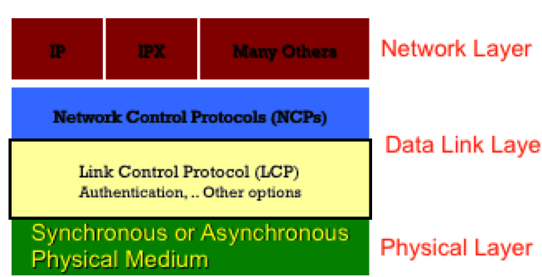
LCP
Link establish: The process of bringing up the PPP link before any other protocols can begin transmission.
Link configuration: The process of negotiating and setting up the parameters of a link.
Link maintenance: The process of managing an opened link.
Link termination: The process of closing an existing link when it is no longer needed (or when the underlying physical layer connection closes).

Slide 16
LCP
In link configuration, LCP frames are exchanged that enable the two physically-connected devices to negotiate the parameters (configuration options) under which the link will operate.
Device1 sends a configure request frame, containing configuration options.
Device2 responds with a frame confirming that the options are okay, suggesting different options or rejecting the options.
Configure-nak
Configure-reject
Notes:
This exchange takes place in both directions and when a station has sent and received an acknowledge packet the link layer is declared open.
The other device (let's call it sayâ€¦ device B J) receives the Configure-Request and processes it. It then has three choices of how to respond:
If every option in it is acceptable in every way, device B sends back a Configure-Ack (â€œacknowledgeâ€). The negotiation is complete.
If all the options that device A sent are valid ones that device B recognizes and is capable of negotiating, but it doesn't accept the values device A sent, then device B returns a Configure-Nak (â€œnegative acknowledgeâ€) frame. This message includes a copy of each configuration option that B found unacceptable.
If any of the options that A sent were either unrecognized by B, or represent ways of using the link that B considers not only unacceptable but not even subject to negotiation, it returns a Configure-Reject containing each of the objectionable options.

Slide 17
LCP Configuration Options
LCP offers PPP different options, including the following:
Maximum-Receive-Unit (MRU): Lets a device specify the maximum size datagram it wants the link to be able to carry.
Authentication-Protocol: the device can indicate the type of authentication protocol it wishes to use (if any).
Compression: Allows the device to specify that it wants to use a compression. This is used to increase the throughput of PPP connections
Quality-Protocol: If the device wants to enable quality monitoring on the link, what protocol to use
Other options: Error detection, Magic Number, Multilink

Slide 18
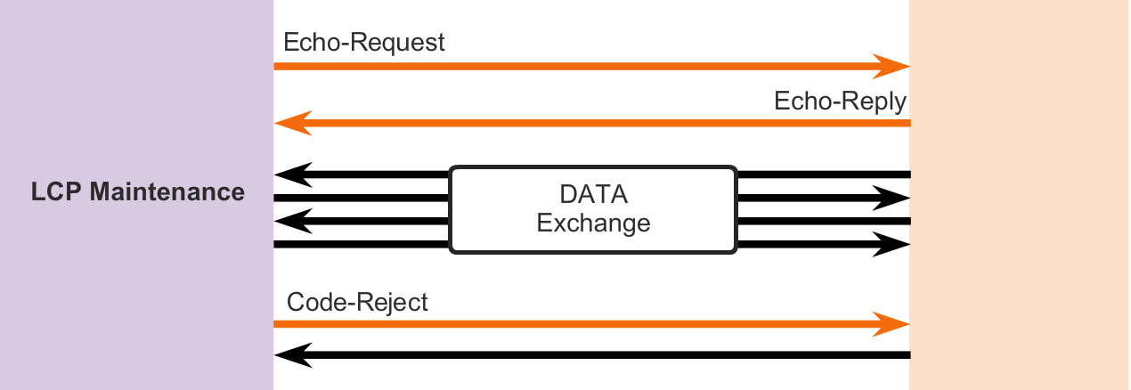
LCP
During link maintenance, LCP can use messages to provide feedback and test the link
Echo-Request, Echo-Reply, and Discard-Request - These frames can be used for testing the link.
Code-Reject and Protocol-Reject - These frame types provide feedback when one device receives an invalid frame due to either an unrecognized LCP code (LCP frame type) or a bad protocol identifier.

Slide 19
LCP
The LCP closes the link by exchanging Terminate packets.
A termination request indicates that the device sending it needs to close the link.
When the link is closing, PPP informs the network layer protocols so that they may take appropriate action.
Notes:
PPP can terminate the link at any time. This might happen because of the loss of the carrier, authentication failure, link quality failure, the expiration of an idle-period timer, or the administrative closing of the link.
The device initiating the shutdown (which may not be the one that initiated the link in the first place) sends a Terminate-Request message. The other device replies back with a Terminate-Ack.

Slide 20
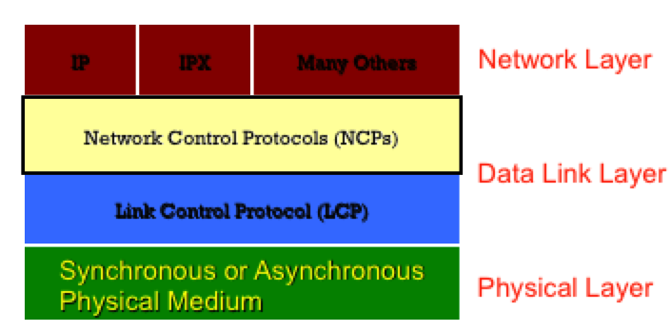
NCP
PPP use the NCP to permit multiple network layer protocols to operate on the same communications link.

Slide 21
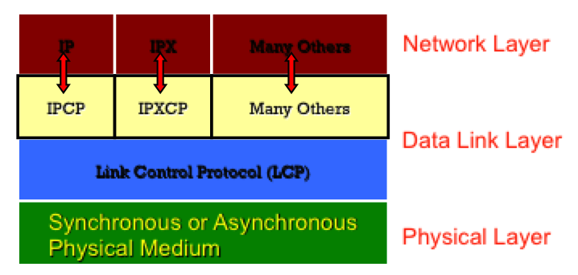
NCP
For every network layer protocol used, PPP uses a separate NCP. For example, IPv4 uses the IP Control Protocol (IPCP) and IPv6 uses IPv6 Control Protocol (IPv6CP).

Slide 22
PPP authentication protocols
Both protocols involve exchanges of messages between the two PPP devices, but there are differences in detail.

Slide 23
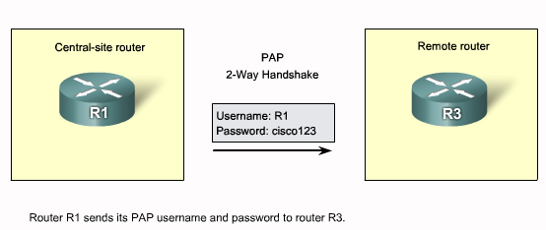
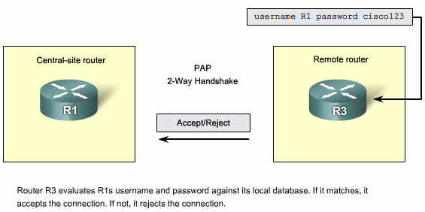
PAP
Notes:
With PAP, the device to be authenticated starts the message exchange by sending a clear text password, claiming to be legitimate.
The device at the other end of PPP link compares the password with its own password and if the password is correct, sends back an acknowledgement.
The authentication process is one way and one or both devices can authenticate each other separately.
PAP is simple in operation as well as configuration but it is insecure because the password is sent in clear text and can be sniffed.

Slide 24
Password Authentication Protocol (PAP)
PAP provides a simple method for a remote node to establish its identity, using a two-way handshake.
The authentication process is one way authentication method and one or both devices can authenticate each other separately.
PAP is not a strong authentication protocol.
Passwords are sent across the link in clear text and there is no protection from playback or repeated trial-and-error attacks.
Notes:
After the PPP link establishment phase is complete, a username/password pair is repeatedly sent by the remote node across the link until authentication is acknowledged or the connection is terminated.

Slide 25
CHAP

Slide 26
CHAP
CHAP uses a three-way handshake to verify the identity of the remote node.
After the PPP link establishment phase is complete, the local router sends a "challenge" message to the remote node.
The remote node responds with a value calculated using a one-way hash function, which is typically Message Digest 5 (MD5).
This response is based on the password and challenge message.
The local router checks the response against its own calculation of the expected hash value.
If the values match, the authentication is acknowledged, otherwise the connection is immediately terminated.

Slide 27
CHAP
CHAP provides protection against playback attack through the use of a variable challenge value that is unique and unpredictable.
Since the challenge is unique and random, the resulting hash value will also be unique and random.

Slide 28
3- Network Layer Protocol Phase
In this phase the PPP devices send NCP packets to choose and configure one or more network layer protocols, such as IP.
Once each of the chosen network layer protocols has been configured, packets from each network layer protocol can be sent over the link.
The PPP link remains configured for communications until LCP or NCP frames close the link.

Slide 29
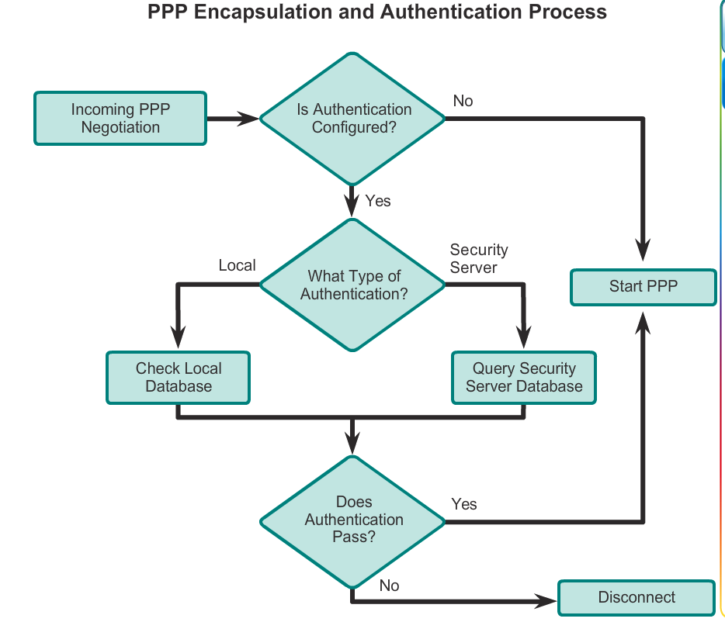
PAP
CHAP

